Slide 1
Swarm Driving with Deep Learning
Presented by- Md Limon Apu

Slide 2
Agenda
Introduction
Types of communication.
Algorithms.
Use case.
Advantages and Disadvantages.

Slide 3
Introduction
Use multiple vehicles to cooperate and coordinate their actions.
Vehicles or agents communicate and cooperate with each other to make decisions.
Swarm driving systems rely on autonomous control technologies.
Swarm driving can improve traffic flow and reduce congestion.

Slide 4
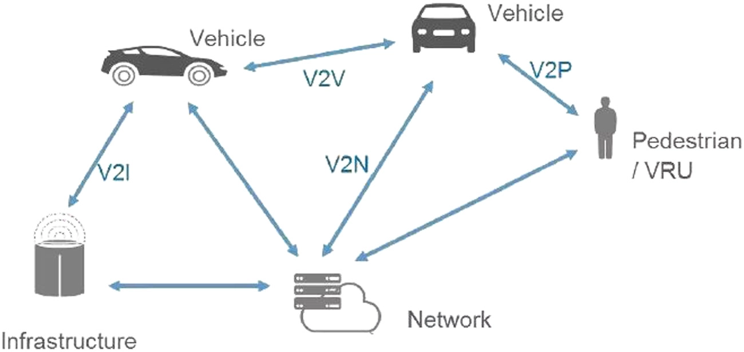
Types of communication
Vehicle-to-vehicle (V2V) communication
Minimizing delay between sending and receiving messages.
have sufficient range to allow vehicles to exchange information.
Able to support real-time communication between vehicles.
Vehicle-to-infrastructure (V2I) communication
Enables vehicles to communicate with roadside infrastructure.
Real-time information on traffic conditions, weather, and road hazards.

Slide 5
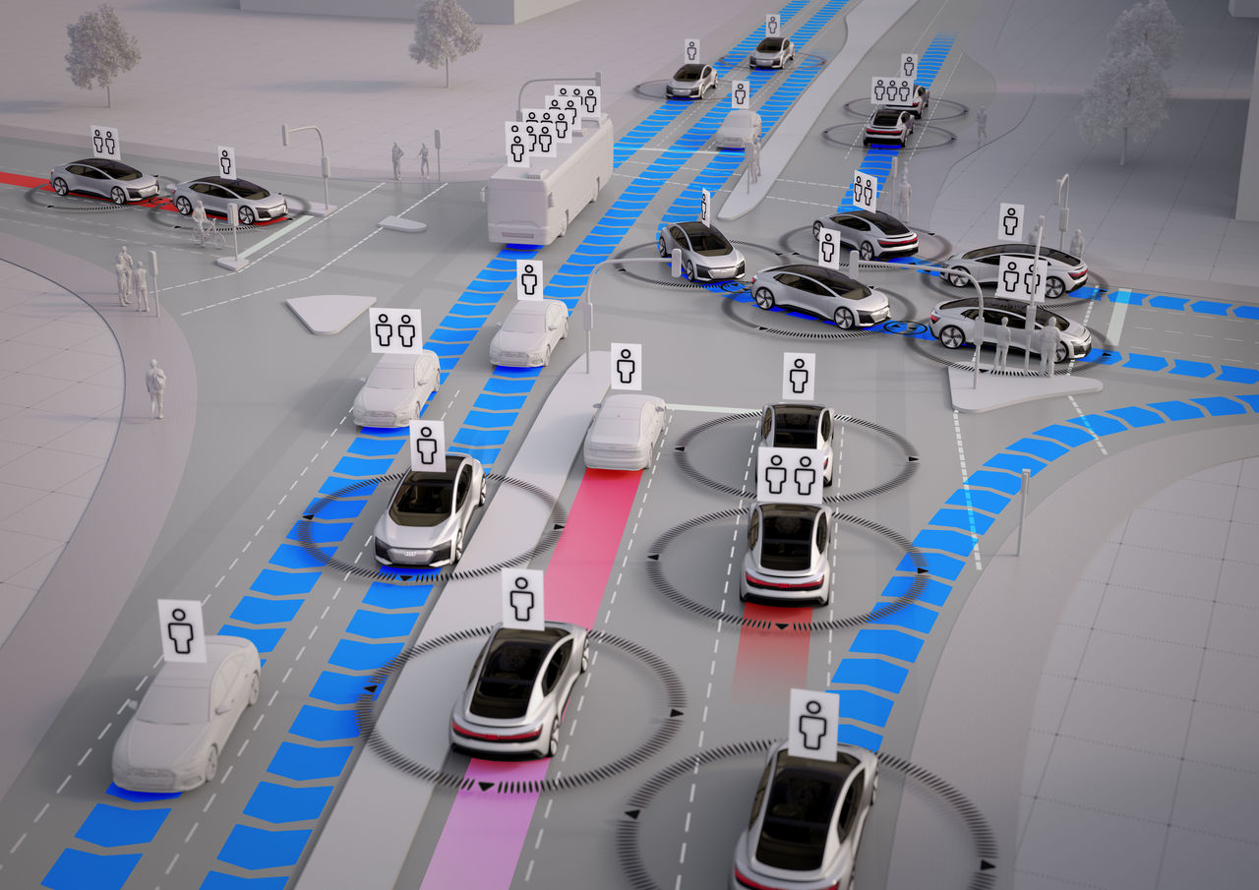
Algorithms
Behavior-based algorithms
Follow the rules based on its sensors and other inputs.
Multi-agent systems.
Rely on vehicle communication and make complex decision-making processes.
Machine learning algorithms.
Trained to recognize pedestrians or other objects.

Slide 6
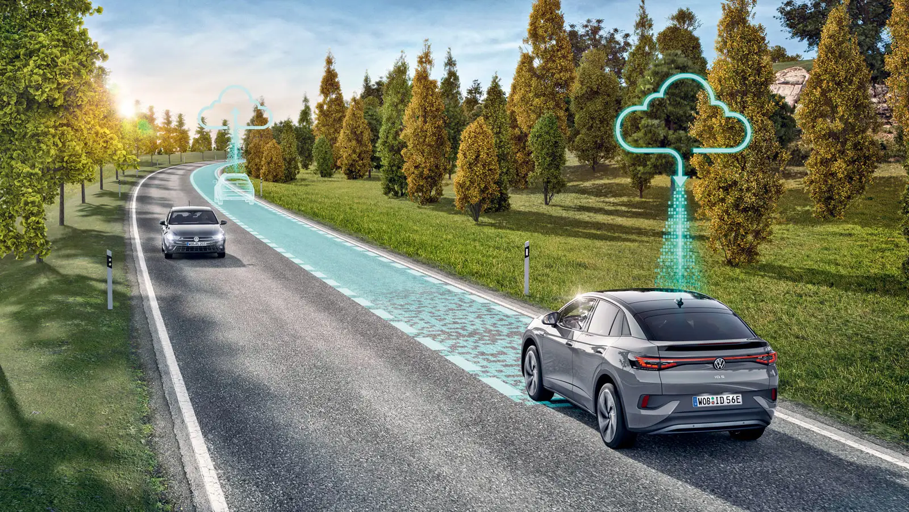
Use Case(Platooning)
Enables a group of vehicles to travel in unison.
Employs a wireless communication system and radar sensors to enable trucks to follow the lead vehicle.
Scikit learning algorithm has been implemented to determine the leader vehicle.
Algorithm used the analytic to make some basic analysis from that data set.

Slide 7
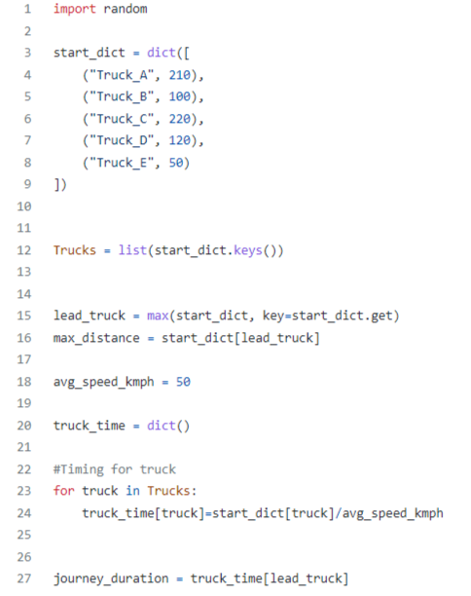
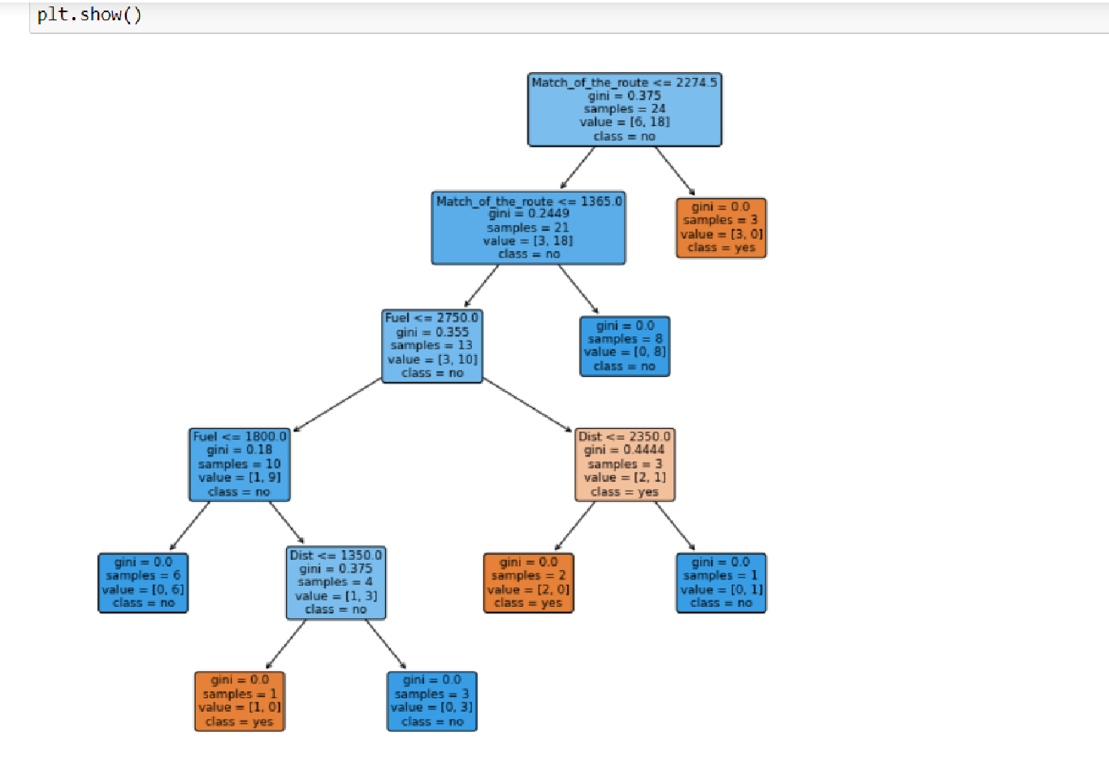
Implementation

Slide 8
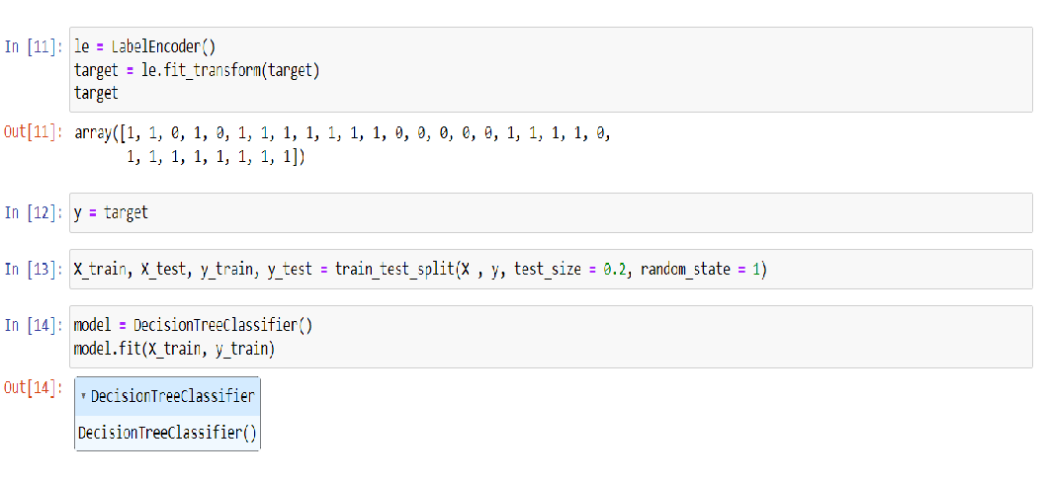
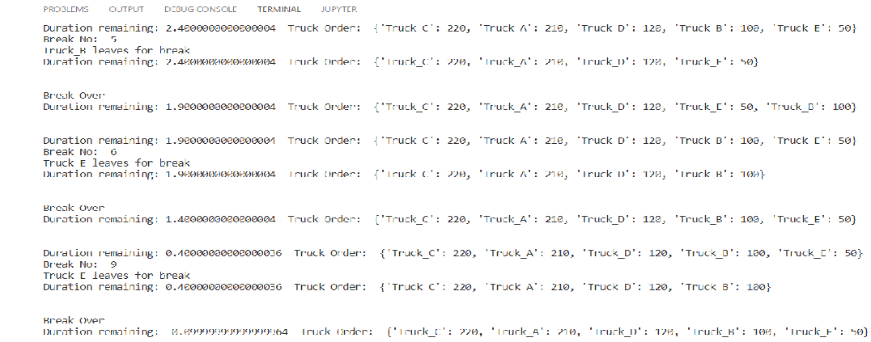
Implementation

Slide 9
Advantages and Disadvantages
Improved traffic flow.
Increased safety.
Reduced environmental impact.
Ensuring reliable communication.
Systems require significant investments.
Legal and regulatory challenges.

Slide 10
Thank You

